Slide 1
Sign Language Recognition
Step Spatial Attention

Slide 2
Design of Network
Faster RCNN
CV2
Input Video
Encoder
CNN
FC
Self Attention
result
Hourglass
……
……
……
Spatio Attention
layer
TemporalAttention
layer

Slide 3
Design of Network
OpenCV2
Unstable, unprecise, rapid
potential for real-time working
Hourglass
Stable, memory-cosuming
Faster RCNN
CV2
Input Video
Hourglass
……
……
Spatio Attention
layer

Slide 4
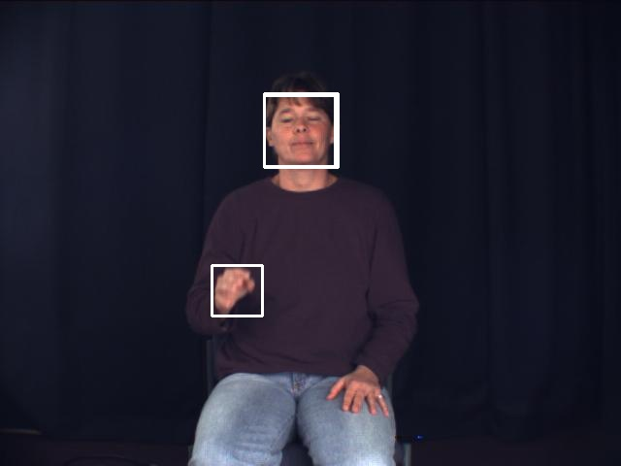
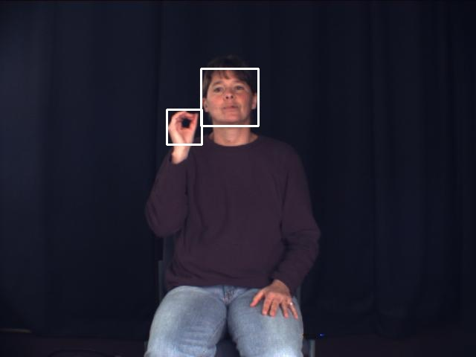
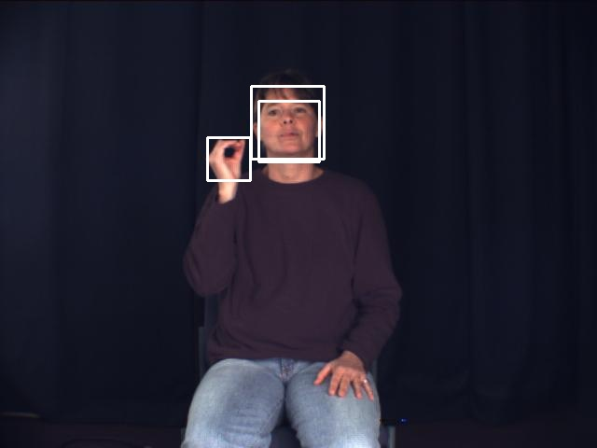
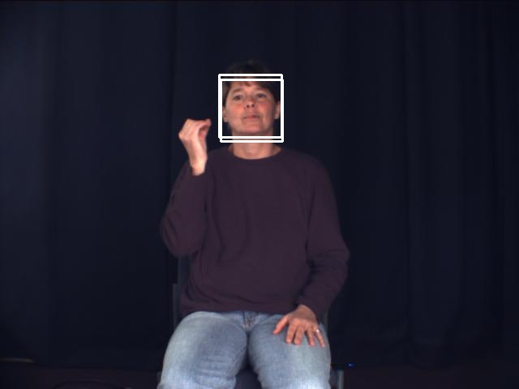

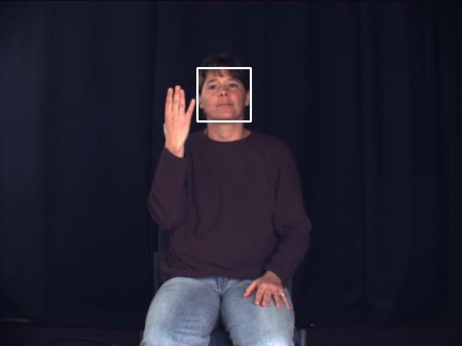
OpenCV

Slide 5
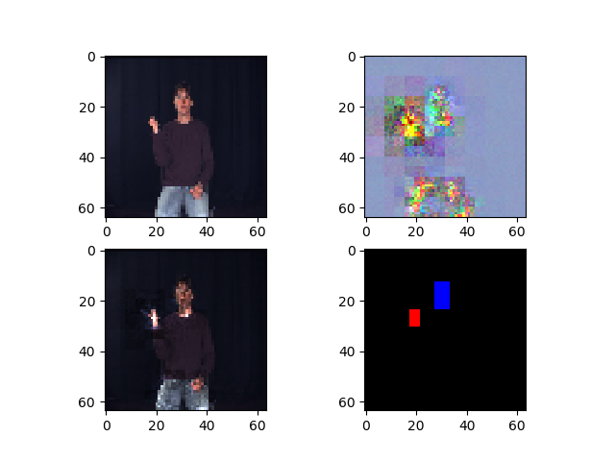
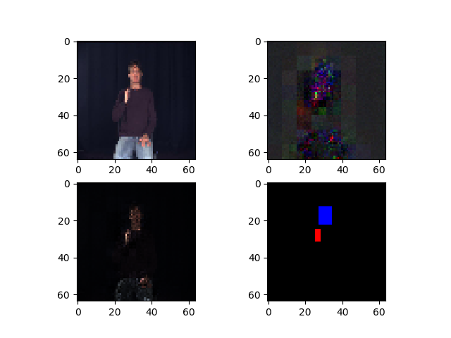
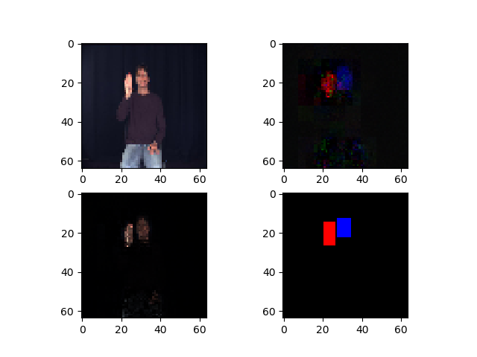
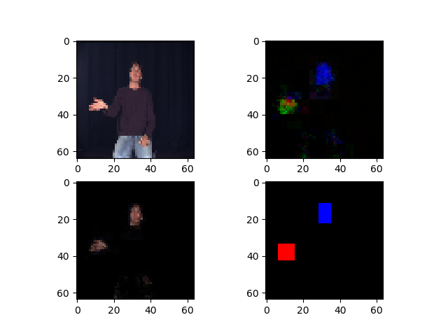
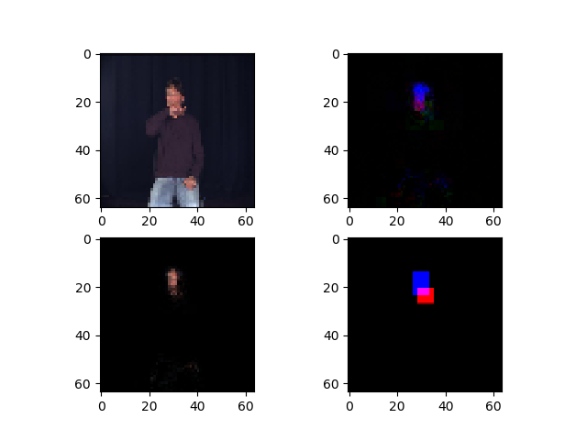
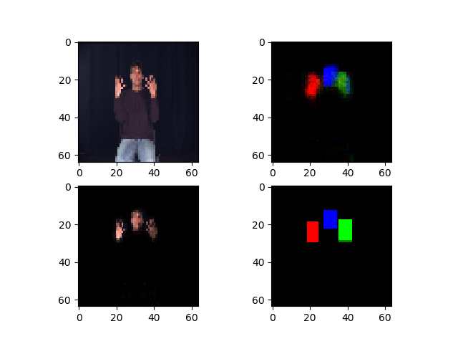
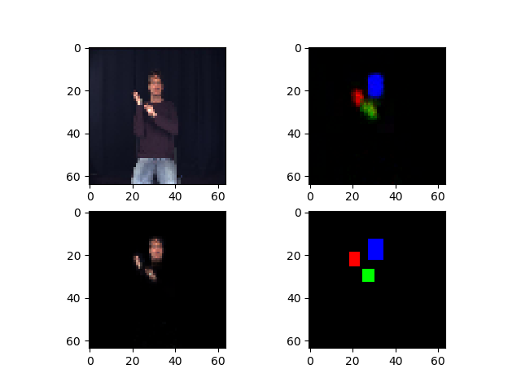
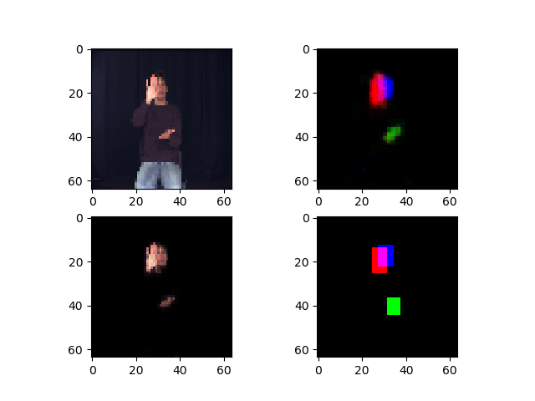
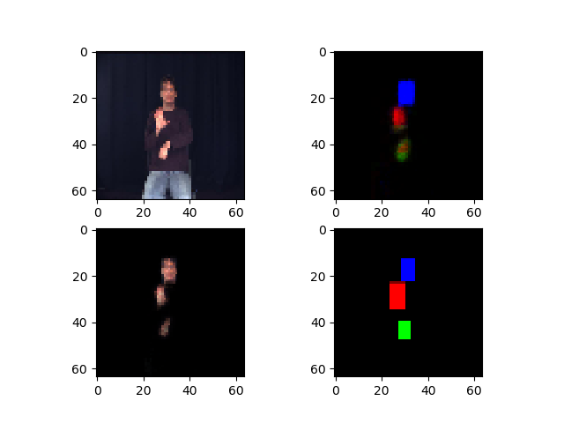
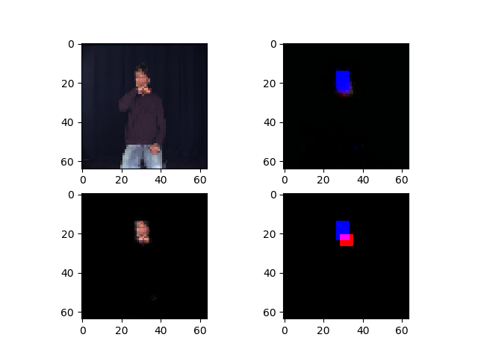
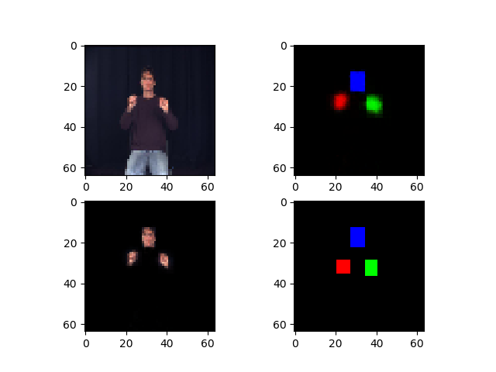
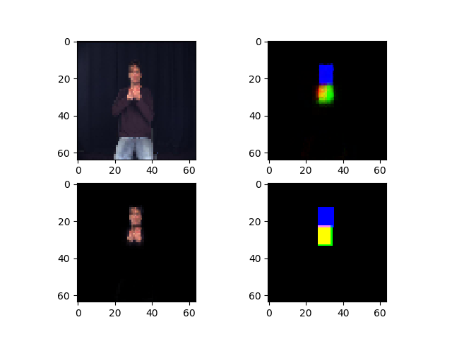
Hourglass Network

Slide 6
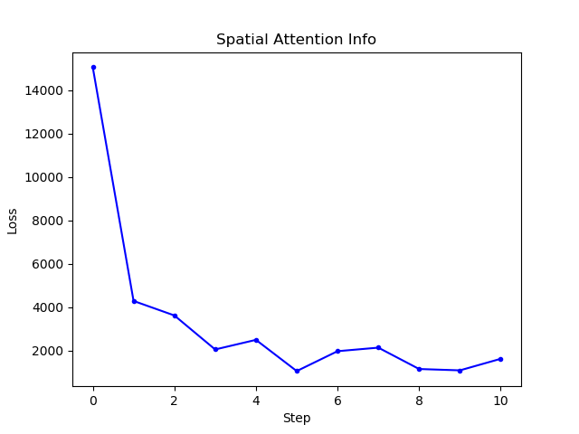
Hourglass

Slide 7
Further Work
Process label data for final classification.
Design temporal attention model.
Do more experiments about spatial attention by ajusting parameters, building new models.

